Slide 1
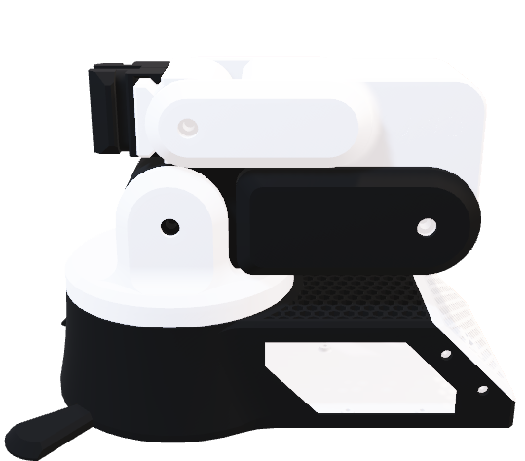
Robotic Arm
Team:
Amr Osama Abd-Allah
Abd-Alrahman Yehya
Fatma Sayed
Shahd Osama
Mohanad Talaat
Mia Ashraf

Slide 2
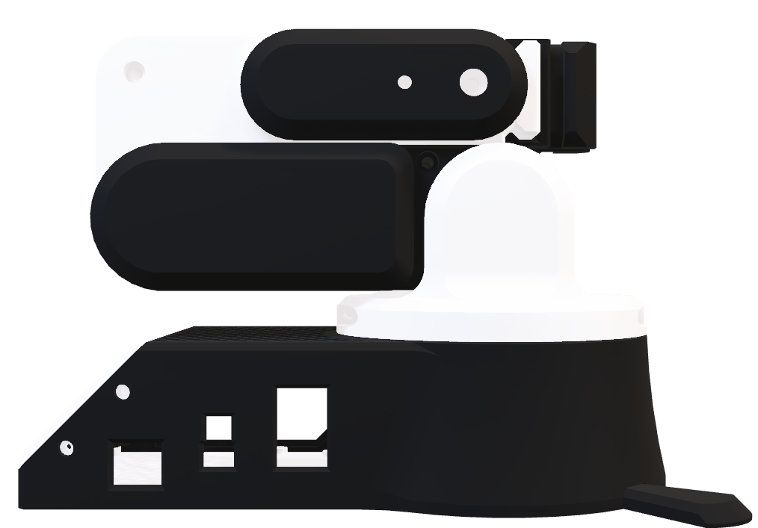
Robotic Arm
Team:
Amr Osama Abd-Allah
Abd-Elrahman Yehya
Fatma Sayed
Shahd Osama
Mohanad Talaat
Mai Ashraf

Slide 3
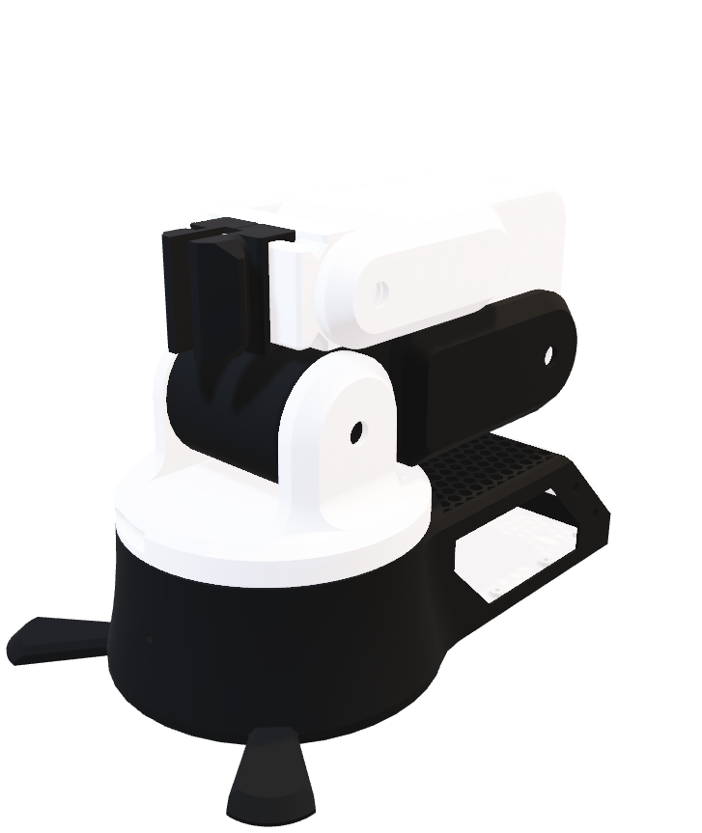
Design Configuration:
Base
DOF = 1
Provides stability and allows rotation of entire arm from 0 to 180 Degree.
Shoulder
DOF = 2 (Yaw,Pitch)
Allows the arm to move in multiply directions
from 0 to 180 Degree.
Elbow
DOF = 1 (Pitch)
Allows flexion and extension of the arm which is connected to 40tooth gear.
Wrist
DOF = 2 (Yaw,Pitch)
Allows the Gripper to orient in multiply directions.
Gripper
DOF = 1 (Open/Close)
Grape and release objects.
Robotic Arm

Slide 4
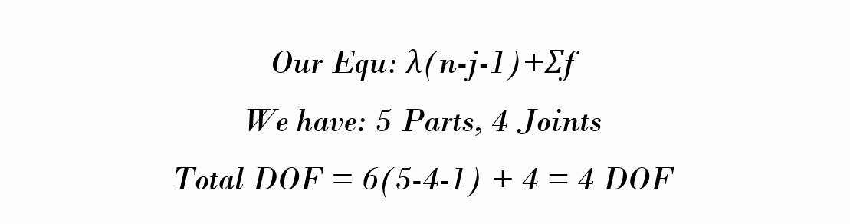
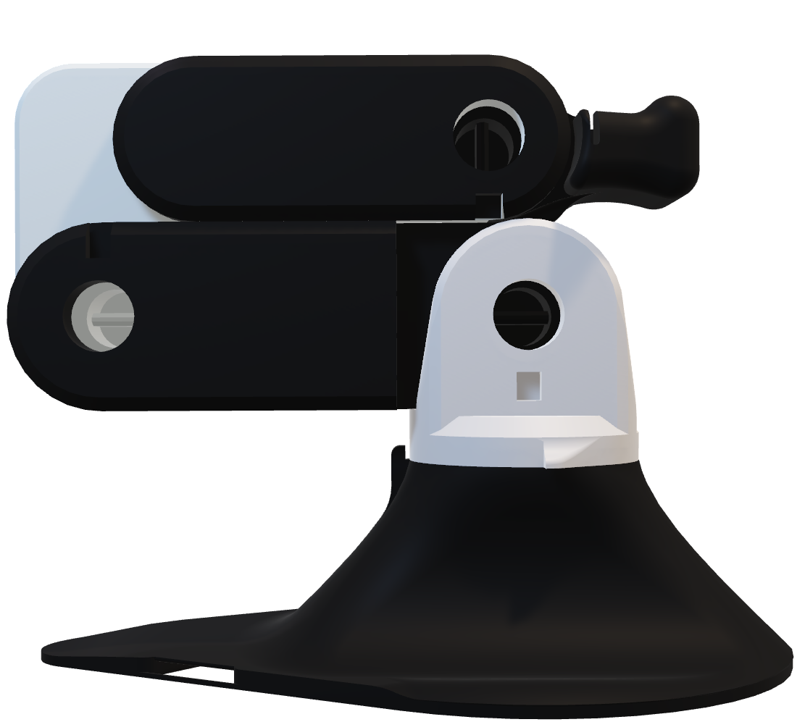
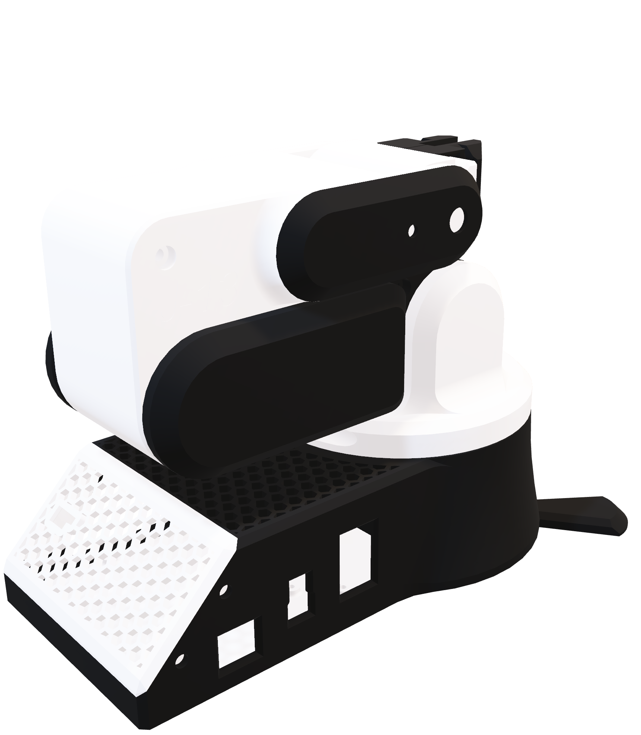
Design Configuration:
Base
DOF = 1
Provides stability and allows rotation of entire arm from 0 to 180 Degree.
Shoulder
DOF = 2 (Yaw,Pitch)
Allows the arm to move in multiply directions
from 0 to 180 Degree.
Total DOF:
Elbow
DOF = 1 (Pitch)
Allows flexion and extension of the arm which is connected to 40tooth gear.
Wrist
DOF = 2 (Yaw,Pitch)
Allows the Gripper to orient in multiply directions.
Gripper
DOF = 1 (Open/Close)
Grape and release objects.
Robotic Arm

Slide 5
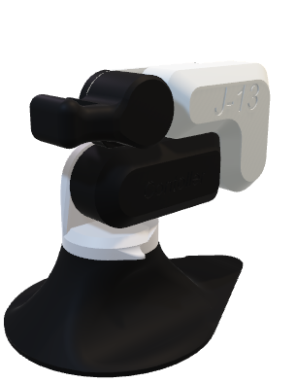
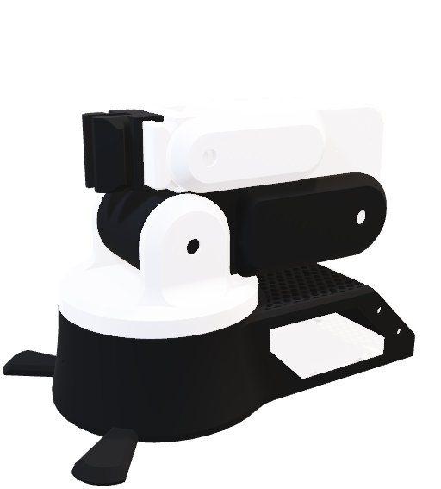
Controlling:
Design Configuration:
Total DOF:
Base
DOF = 1
Provides stability and allows rotation of entire arm from 0 to 180 Degree.
Shoulder
DOF = 2 (Yaw,Pitch)
Allows the arm to move in multiply directions
from 0 to 180 Degree.
We have a controller uses potentiometers to control each joint's servo, allowing manual control of the robotic arm’s position. The button toggles the gripper between open and closed states, simulating a "grab" and "release" functionality. This is useful for creating a simple, manually controlled robotic arm with limited automation.
Elbow
DOF = 1 (Pitch)
Allows flexion and extension of the arm which is connected to 40tooth gear.
Wrist
DOF = 2 (Yaw,Pitch)
Allows the Gripper to orient in multiply directions.
Gripper
DOF = 1 (Open/Close)
Grape and release objects.
Robotic Arm

Slide 6
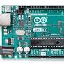
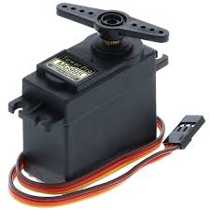
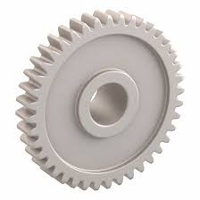
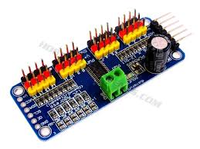
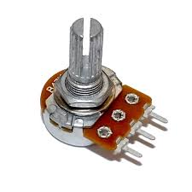
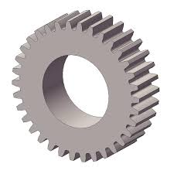
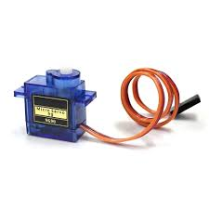
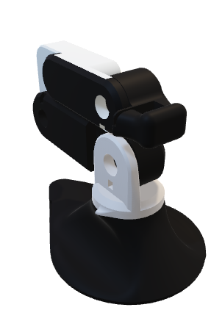
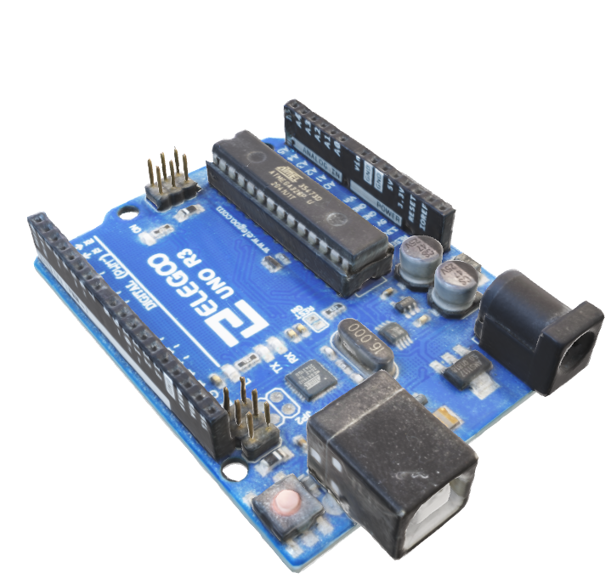
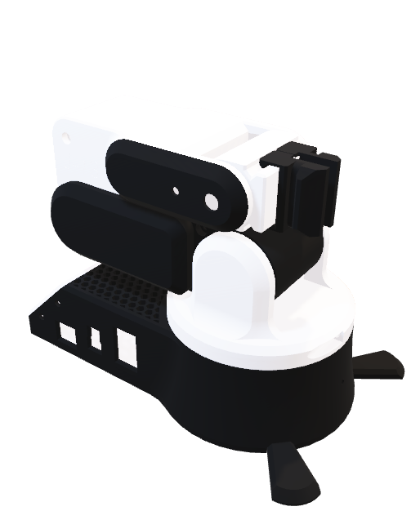
Controlling:
Hardware Requirements
Design Configuration:
Total DOF:
We have a controller uses potentiometers to control each joint's servo, allowing manual control of the robotic arm’s position. The button toggles the gripper between open and closed states, simulating a "grab" and "release" functionality. This is useful for creating a simple, manually controlled robotic arm with limited automation.
Base
DOF = 1
Provides stability and allows rotation of entire arm from 0 to 180 Degree.
Shoulder
DOF = 2 (Yaw,Pitch)
Allows the arm to move in multiply directions
from 0 to 180 Degree.
Arduino Uno
4-Servo Motors
2-40 Tooth Gear
Elbow
DOF = 1 (Pitch)
Allows flexion and extension of the arm which is connected to 40tooth gear.
Wrist
DOF = 2 (Yaw,Pitch)
Allows the Gripper to orient in multiply directions.
Gripper
DOF = 1 (Open/Close)
Grape and release objects.
Servo Module Driver
Potential Resistor
34 Tooth Gear
Micro Servo Motor
Robotic Arm

Slide 7
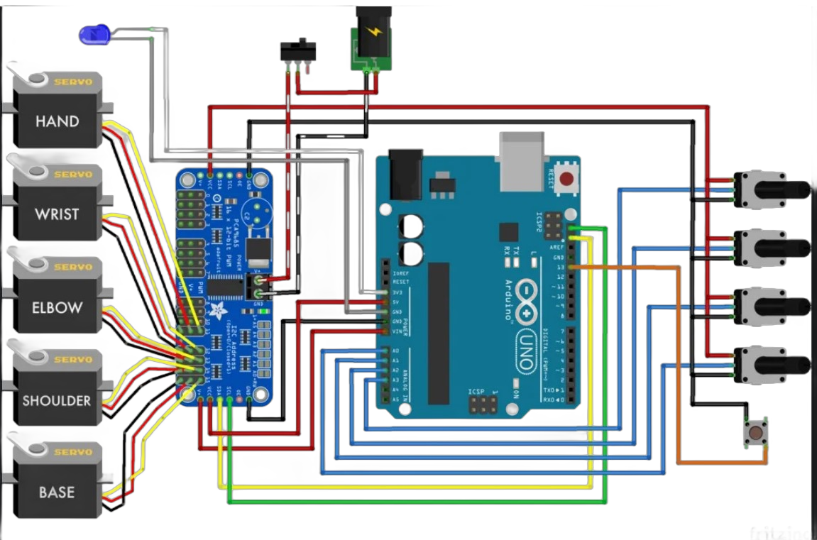
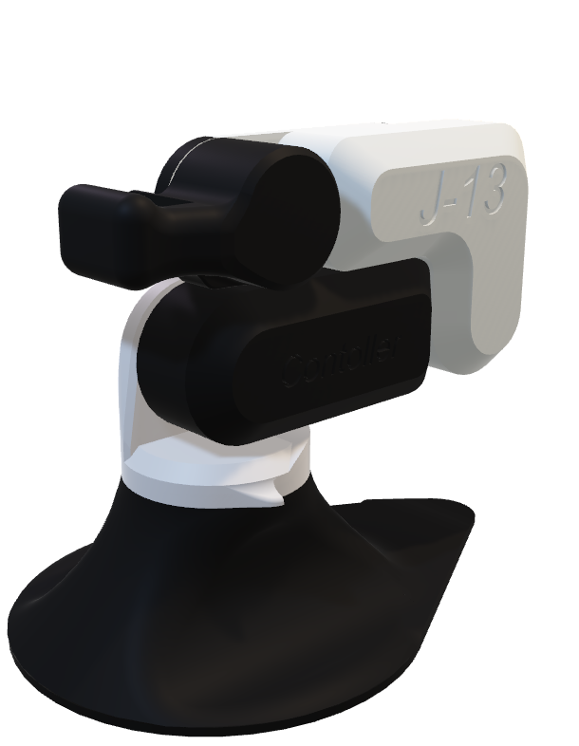
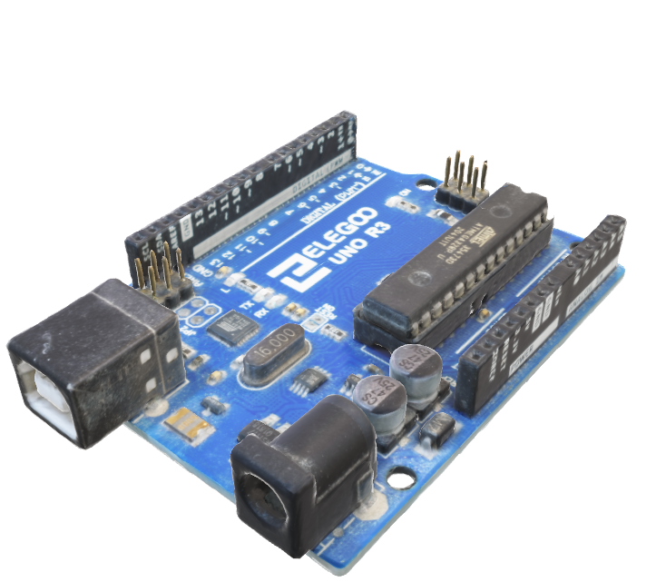

Hardware Requirements
Arduino Uno
4-Servo Motors
2-40 Tooth Gear
We have a controller uses potentiometers to control each joint's servo, allowing manual control of the robotic arm’s position. The button toggles the gripper between open and closed states, simulating a "grab" and "release" functionality. This is useful for creating a simple, manually controlled robotic arm with limited automation.
Controlling:
Servo Module Driver
Potential Resistor
34 Tooth Gear
Micro Servo Motor
Software Requirements:
Design Configuration:
Total DOF:
Base
DOF = 1
Provides stability and allows rotation of entire arm from 0 to 180 Degree.
Shoulder
DOF = 2 (Yaw,Pitch)
Allows the arm to move in multiply directions
from 0 to 180 Degree.
The Arduino IDE is used to write and upload the code to the Arduino Uno microcontroller. It provides a user-friendly interface for programming the robotic arm.
Elbow
DOF = 1 (Pitch)
Allows flexion and extension of the arm which is connected to 40tooth gear.
Wrist
DOF = 2 (Yaw,Pitch)
Allows the Gripper to orient in multiply directions.
Gripper
DOF = 1 (Open/Close)
Grape and release objects.
Arduino IDE
Robotic Arm

Slide 8
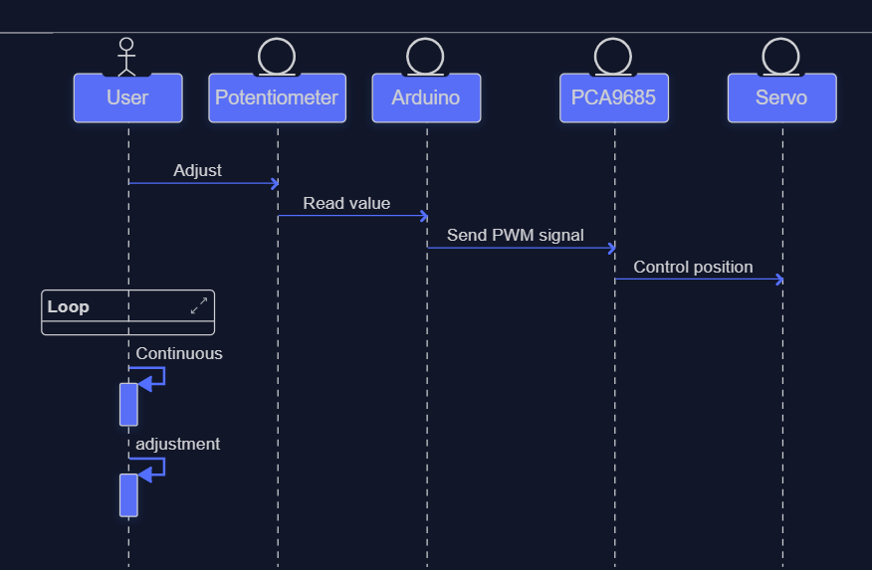
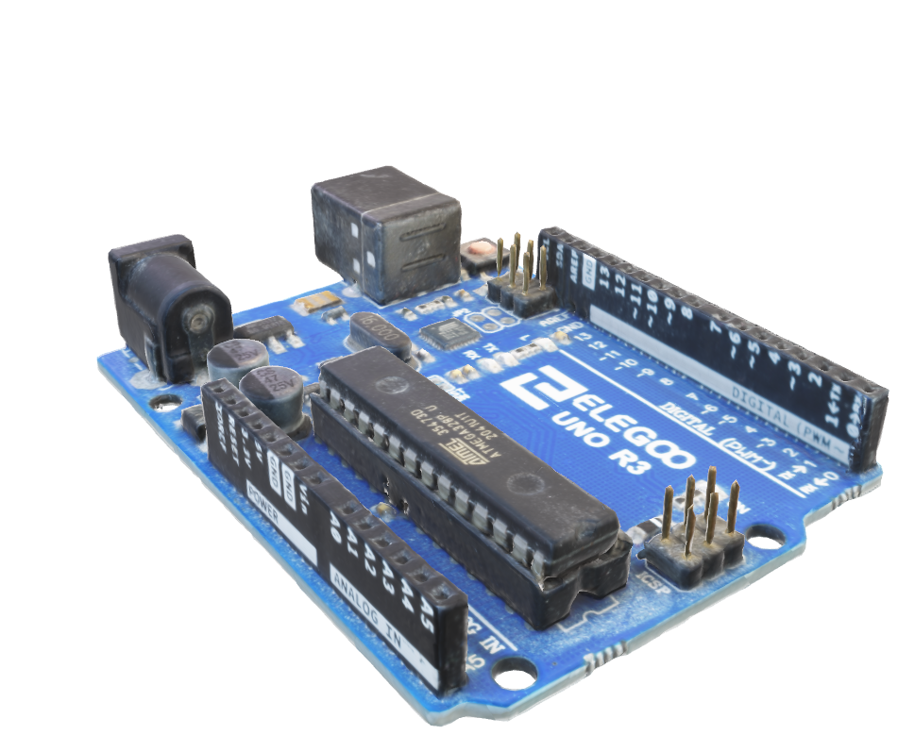
Hardware Requirements
We have a controller uses potentiometers to control each joint's servo, allowing manual control of the robotic arm’s position. The button toggles the gripper between open and closed states, simulating a "grab" and "release" functionality. This is useful for creating a simple, manually controlled robotic arm with limited automation.
Software Requirements:
Controlling:
The Arduino IDE is used to write and upload the code to the Arduino Uno microcontroller. It provides a user-friendly interface for programming the robotic arm.
Arduino Uno
4-Servo Motors
2-40 Tooth Gear
Servo Module Driver
Potential Resistor
34 Tooth Gear
Micro Servo Motor
Circuit Diagram:
Design Configuration:
Total DOF:
Base
DOF = 1
Provides stability and allows rotation of entire arm from 0 to 180 Degree.
Shoulder
DOF = 2 (Yaw,Pitch)
Allows the arm to move in multiply directions
from 0 to 180 Degree.
Elbow
DOF = 1 (Pitch)
Allows flexion and extension of the arm which is connected to 40tooth gear.
Wrist
DOF = 2 (Yaw,Pitch)
Allows the Gripper to orient in multiply directions.
Gripper
DOF = 1 (Open/Close)
Grape and release objects.
Robotic Arm
Arduino IDE

Slide 9
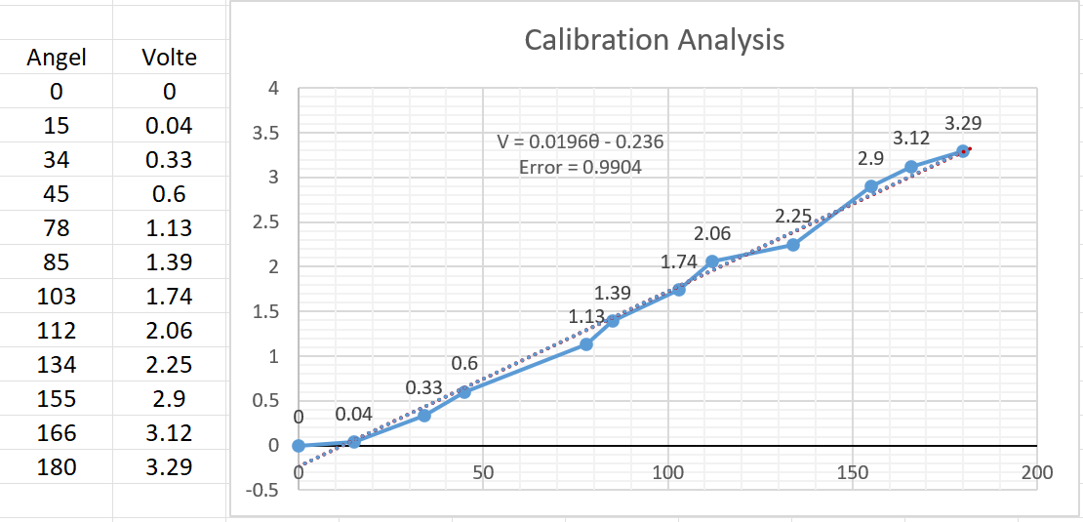

Hardware Requirements
We have a controller uses potentiometers to control each joint's servo, allowing manual control of the robotic arm’s position. The button toggles the gripper between open and closed states, simulating a "grab" and "release" functionality. This is useful for creating a simple, manually controlled robotic arm with limited automation.
Software Requirements:
Controlling:
The Arduino IDE is used to write and upload the code to the Arduino Uno microcontroller. It provides a user-friendly interface for programming the robotic arm.
Arduino Uno
4-Servo Motors
2-40 Tooth Gear
Servo Module Driver
Potential Resistor
34 Tooth Gear
Circuit Diagram:
Micro Servo Motor
Block Diagram:
Design Configuration:
Total DOF:
Base
DOF = 1
Provides stability and allows rotation of entire arm from 0 to 180 Degree.
Shoulder
DOF = 2 (Yaw,Pitch)
Allows the arm to move in multiply directions
from 0 to 180 Degree.
Elbow
DOF = 1 (Pitch)
Allows flexion and extension of the arm which is connected to 40tooth gear.
Wrist
DOF = 2 (Yaw,Pitch)
Allows the Gripper to orient in multiply directions.
Gripper
DOF = 1 (Open/Close)
Grape and release objects.
Robotic Arm
Arduino IDE

Slide 10
Hardware Requirements
We have a controller uses potentiometers to control each joint's servo, allowing manual control of the robotic arm’s position. The button toggles the gripper between open and closed states, simulating a "grab" and "release" functionality. This is useful for creating a simple, manually controlled robotic arm with limited automation.
Software Requirements:
Controlling:
The Arduino IDE is used to write and upload the code to the Arduino Uno microcontroller. It provides a user-friendly interface for programming the robotic arm.
Arduino Uno
4-Servo Motors
2-40 Tooth Gear
Servo Module Driver
Potential Resistor
34 Tooth Gear
Circuit Diagram:
Micro Servo Motor
Calibration Analysis
Design Configuration:
Total DOF:
Base
DOF = 1
Provides stability and allows rotation of entire arm from 0 to 180 Degree.
Shoulder
DOF = 2 (Yaw,Pitch)
Allows the arm to move in multiply directions
from 0 to 180 Degree.
Elbow
DOF = 1 (Pitch)
Allows flexion and extension of the arm which is connected to 40tooth gear.
Wrist
DOF = 2 (Yaw,Pitch)
Allows the Gripper to orient in multiply directions.
Gripper
DOF = 1 (Open/Close)
Grape and release objects.
Robotic Arm
Block Diagram:
Arduino IDE

Slide 11

Hardware Requirements
We have a controller uses potentiometers to control each joint's servo, allowing manual control of the robotic arm’s position. The button toggles the gripper between open and closed states, simulating a "grab" and "release" functionality. This is useful for creating a simple, manually controlled robotic arm with limited automation.
Software Requirements:
Controlling:
The Arduino IDE is used to write and upload the code to the Arduino Uno microcontroller. It provides a user-friendly interface for programming the robotic arm.
Arduino Uno
4-Servo Motors
2-40 Tooth Gear
Servo Module Driver
Potential Resistor
34 Tooth Gear
Circuit Diagram:
Micro Servo Motor
Design Configuration:
Total DOF:
Base
DOF = 1
Provides stability and allows rotation of entire arm from 0 to 180 Degree.
Shoulder
DOF = 2 (Yaw,Pitch)
Allows the arm to move in multiply directions
from 0 to 180 Degree.
Elbow
DOF = 1 (Pitch)
Allows flexion and extension of the arm which is connected to 40tooth gear.
Wrist
DOF = 2 (Yaw,Pitch)
Allows the Gripper to orient in multiply directions.
Thank You
Gripper
DOF = 1 (Open/Close)
Grape and release objects.
Robotic Arm
Block Diagram:
Calibration Analysis
Arduino IDE

